Slide 1
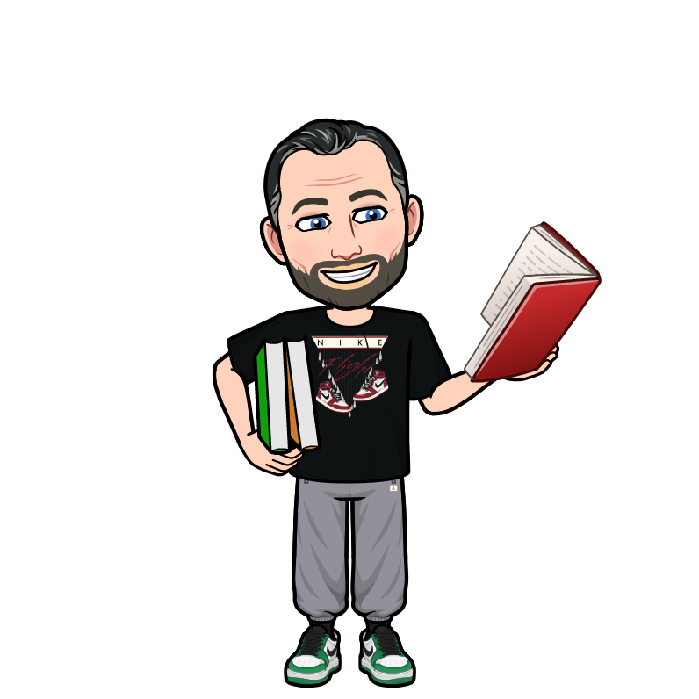
Curriculum Night Plato Academy Clearwater 2nd Grade 2023 Mr. Fordham

Slide 2
Curriculum Night Agenda
Overview of Academics
2nd Grade Florida BEST Standards
Question & Answer Session
Notes:
NOTE: To change images on this slide, select a picture and delete it. Then click the Insert Picture icon in the placeholder to insert your own image.

Slide 3
Reading Block Overview
Reading Program (2nd grade Reading Skills and Grammar) - Houghton Mifflin
Spelling – Spelling Through Houghton Mifflin – spelling words and homework.
Technology – iReady-Each day the kids will work on iReady Reading for 15 minutes.
Small Group and Independent Reading - We will work in small groups with all students. We have centers each day and the kids complete two rotations.
Writing -skills will focus on the main writing genres (narrative, opinion, informative, and descriptive) with emphasis on building complete paragraphs.
Handwriting – review of upper and lower case DeNealian letters and introduction to upper and lower case cursive letters.

Slide 4
Math Block Overview
Math Program - Houghton Mifflin
Technology – iReady-Each day the kids will work on Math iReady for 15 minutes.
Demonstrate – The teacher will demonstrate one of the problems on the first page of the workbook.
Guided Lesson – The teacher will guide the students through several problems and answer any questions.
Independent Practice – The students will have two pages of independent practice in which the teacher will give individual help, if needed. All answers will be checked together on the Smartboard.
*Manipulatives and work mats are used as needed.

Slide 5
Science, Social Studies, Health
Science - Science is taught daily.
Social Studies - Social studies is taught 2 times a week.
Health – Health is taught on Fridays with integrated character education.
iReady – weekly

Slide 6
By the End of 2nd Grade
A look into 2nd Grade Expectations

Slide 7
2nd Grade Florida B.E.S.T. Standards
Standards for all curriculum areas can be found at:
Cpalms.org

Slide 8
How is my child graded in 2nd Grade?

Slide 9
Report Card Grading System – Academics Please if you still don’t have one, make sure to have an account on Portal to check your child’s grades. Ms. Andrea can help you to open an account for you.
E – Excellent – 90% - 100%
V – Very Good – 80% - 89%
S – Satisfactory – 70% - 79%
N – Needs Improvement – 60% - 69%
U – Unsatisfactory – Below 59%

Slide 10
Report Card Grading System – Behavior
E – Excellent – Only “blues”
V – Very Good – “Blues” and “Greens” (maybe 1 “yellow”)
S – Satisfactory – 2 to 3 “yellows”
N – Needs Improvement – 4 to 5 “yellows”
U – Unsatisfactory – 6 “yellows” and above
*”Reds” are counted as 2 “yellows.”

Slide 11
Tests and Assessments
Weekly Spelling, Science
Unit Math and Reading assessments
Monthly Reading Fluency
Monthly Math Facts Test (timed – 25 questions in 1 minute)
Hands-on Projects
BME iReady Diagnostics
Classwork
Reading, Science, Social Studies journals.
Homework
STAR Testing 3x

Slide 12
2nd Grade Homework Project Based Homework: Q1: All About me & Habitat Diorama Q2: Holidays around the world Q3: Math Board Game Q4: Book Report

Slide 13
Water Bottles and Jackets
Students need a leak proof (no glass or metal) water bottle at school every day! No other drink will be allowed besides water.
We strongly encourage students to keep a jacket in their backpacks. Our classroom temperature can vary throughout the day. Jackets must comply with dress code requirements to be worn inside of the school building.

Slide 14
Bathroom Policies
Students are asked to use the restroom before they come to the classroom.
Students are asked to not to use the restroom during instructional time, but may use the bathroom sign to ask during independent work, lunch, recess time, and activities.

Slide 15
Sickness Policy
Please refer to the parent handbook for our sickness policy as the health of our students is of upmost priority.
We would like to emphasize that children must be fever free for 24 hours without medication.
If your child is sent home with a fever, then they must be fever free for 24 hours before returning to school. If your child went home with a fever and arrives the next day, we will call you to pick up your child.

Slide 16
Absences and Tardies
If your child is missing a day of school, please email me within 24 hours to let me know and to give me a reason as to the absence (illness, religious holiday, family vacation, etc).
To have an absence marked as medically excused due to an illness or an injury, you will need to submit a doctor’s note.
Students are considered tardy after 8:40am. Please be aware that three unexcused tardies will be marked as an unexcused absence.
Students are going to be marked tardy when they leave school before the end of the day.

Slide 17
Field Trips
We take 3-4 field trips each year in 2nd Grade. Due to safety and recent vehicle requirements, we travel in a bus for each field trip.
Pinellas County Schools now requires that all volunteers attain a level 2 clearance. This requires the volunteer to have a background screening as well as complete fingerprints. There is a fee for the fingerprints. However, once you obtain level 2, it is good for 5 years.
We strongly encourage parents to obtain level 2 at the beginning of the year. The process can take some time, and all field trip chaperones must be level 2 approved.

Slide 18
Birthdays
Invitations will gladly be placed in each child’s take home folder, however all students in the class have to be invited. Students are not allowed to pass out individual invitations during car circle or in the hallway. We cannot forward digital birthday invitations or reminders to other parents.
Please remember to e-mail me prior to the date you selected to celebrate your child’s birthday. Due to children with food allergies, we cannot accept home made baked items. All foods must be store bought in the sealed, original package and nut free.

Slide 19
Quick Reminders
Please remember to sign agendas each night.
Please do not drop off your child before 8:15. It is unsafe and unsupervised.
Unless previously arranged no student will be dismissed after 2:45 due to class instruction. Yes, there are emergencies, and yes weather may dictate a change, but please respect our classroom, and the learning that is going on.
Please make sure you check our website weekly or more for updated. Our website has very important information like: upcoming events, homework and assignments, and our classroom newsletter.
If you have any questions, or need to let me know about anything, please be sure to either write a note in their agenda or email us (preferred) at:
Fordhamm@platoacademy.net
Notes:
NOTE: To change images on this slide, select a picture and delete it. Then click the Insert Picture icon in the placeholder to insert your own image.

Slide 20
Thanks for Coming Tonight!

